Slide 1
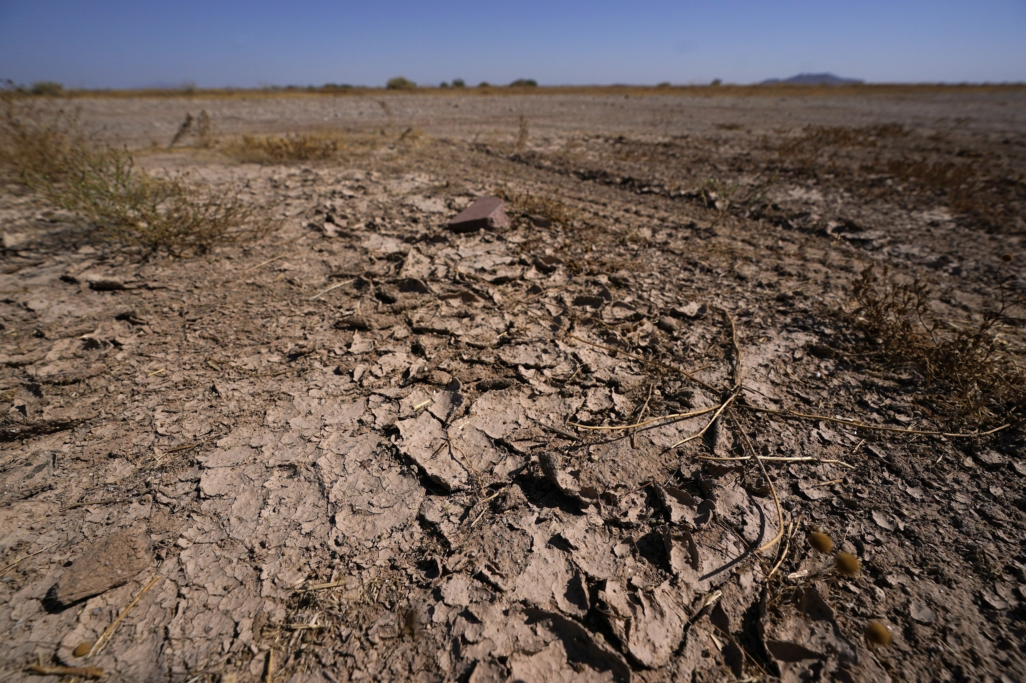
Developing a Flood and Drought Early Warning Network for the Upper Missouri River Basin
Seeking TCU Collaboration
Kyle Bocinsky
Director of Climate Extension
Montana Climate Office
University of Montana

Slide 2
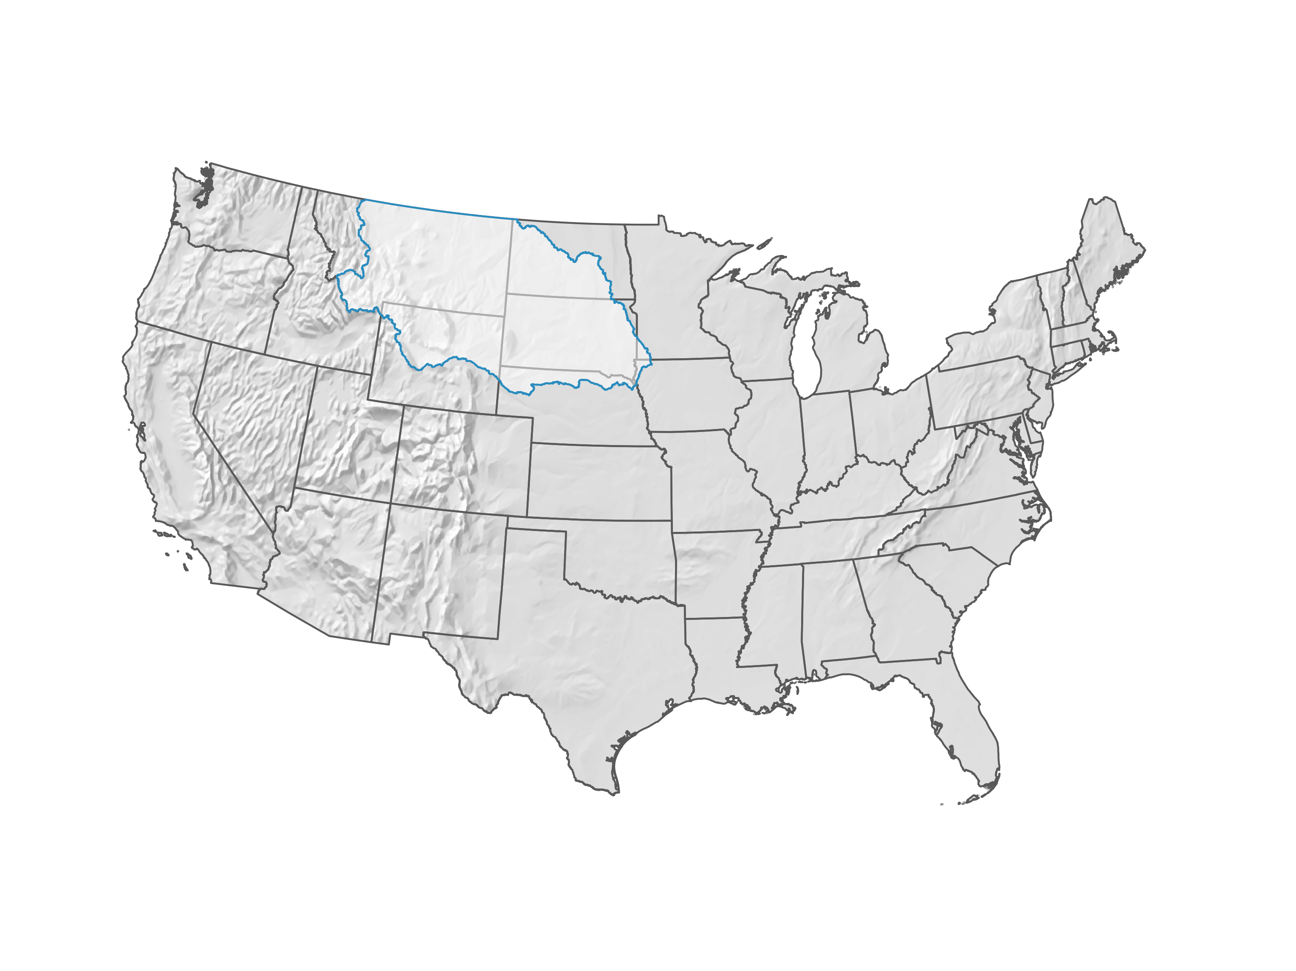
Upper Missouri River Basin

Slide 3
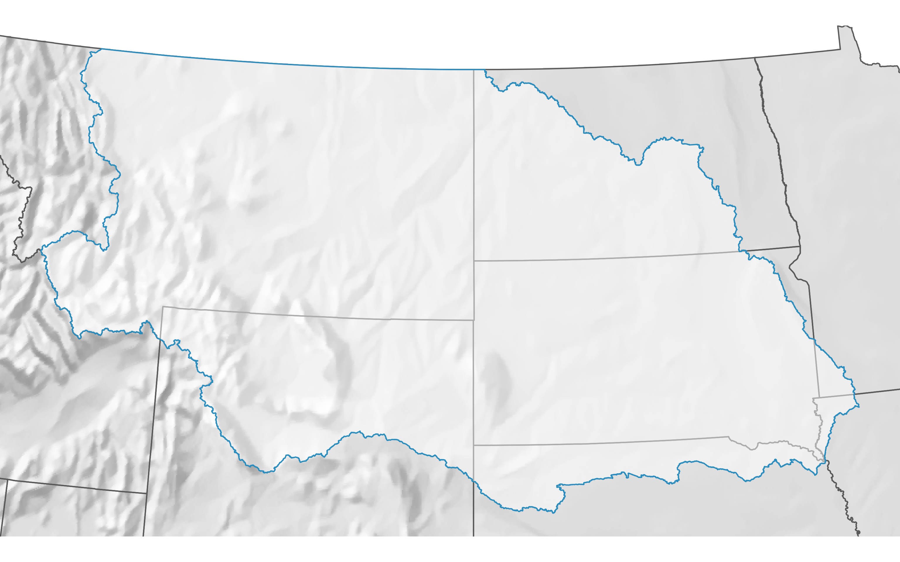
302,000 square miles
2,974,820 people (2020 Census)

Slide 4
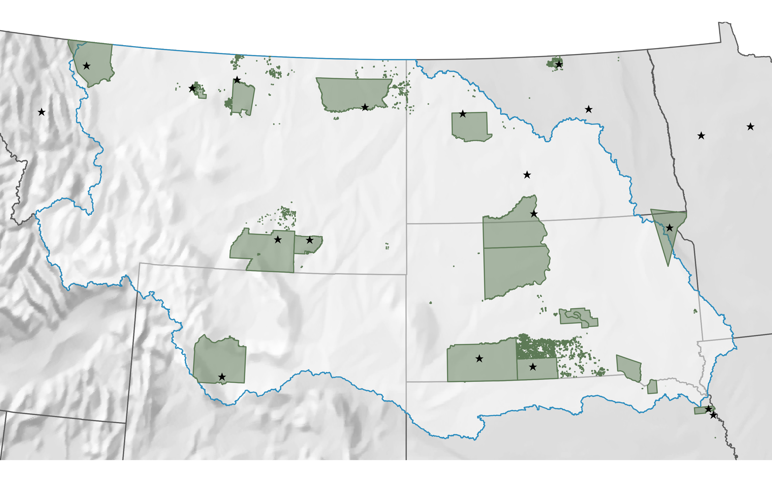
21 Tribal Reservations
145,802 Tribal residents

Slide 7
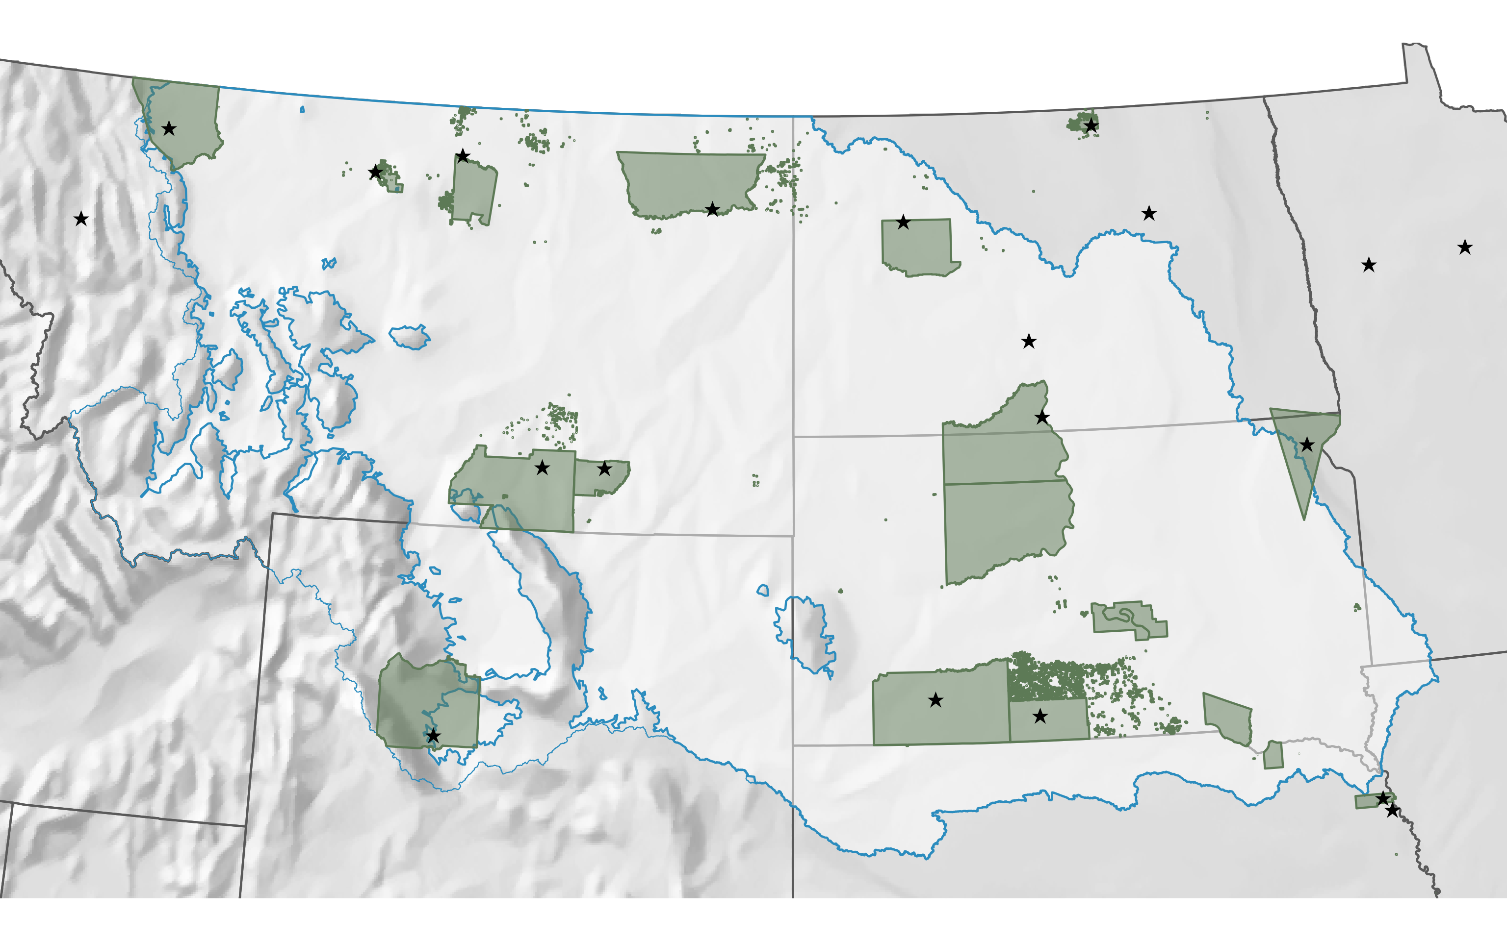
UMRB below 5,500 feet

Slide 8
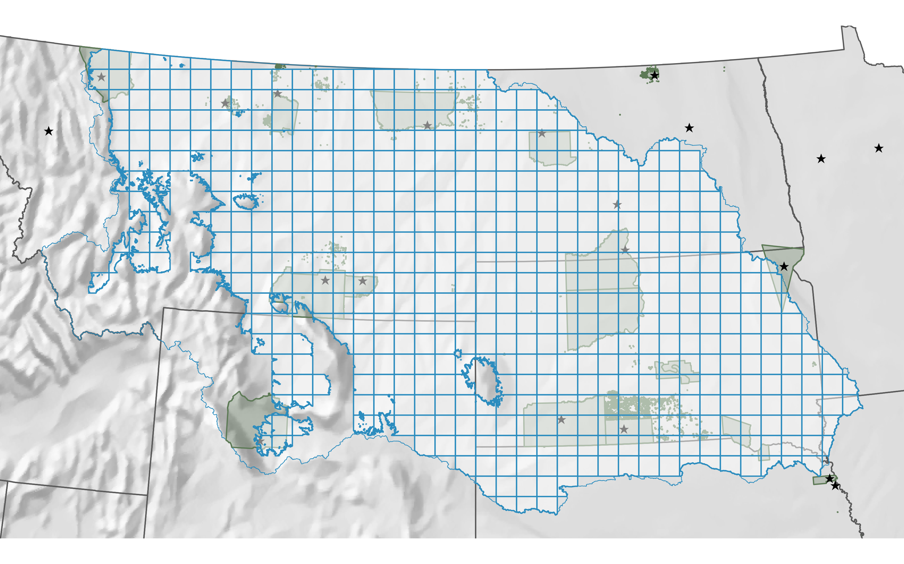
500 square mile grid
540 grid squares

Slide 9
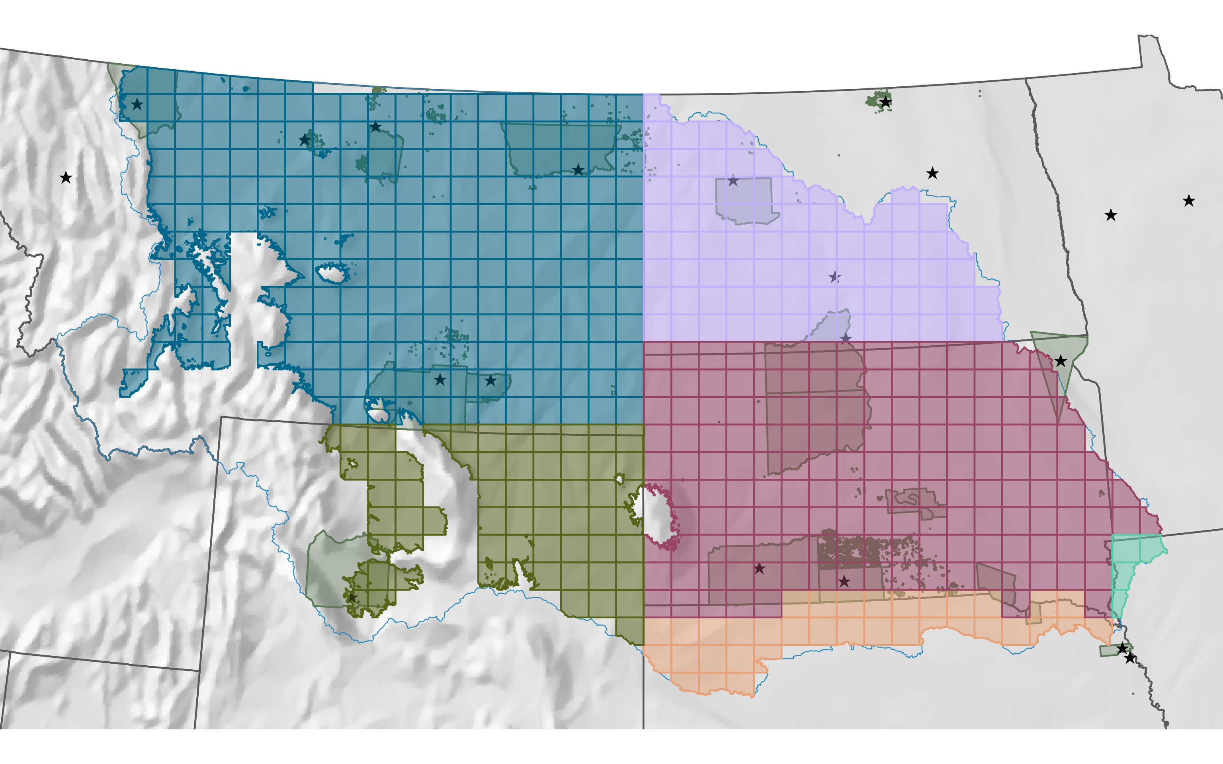
6 State Mesonets
MT: 205
ND: 79
SD: 156
WY: 61
IA: 4
NE: 35

Slide 10
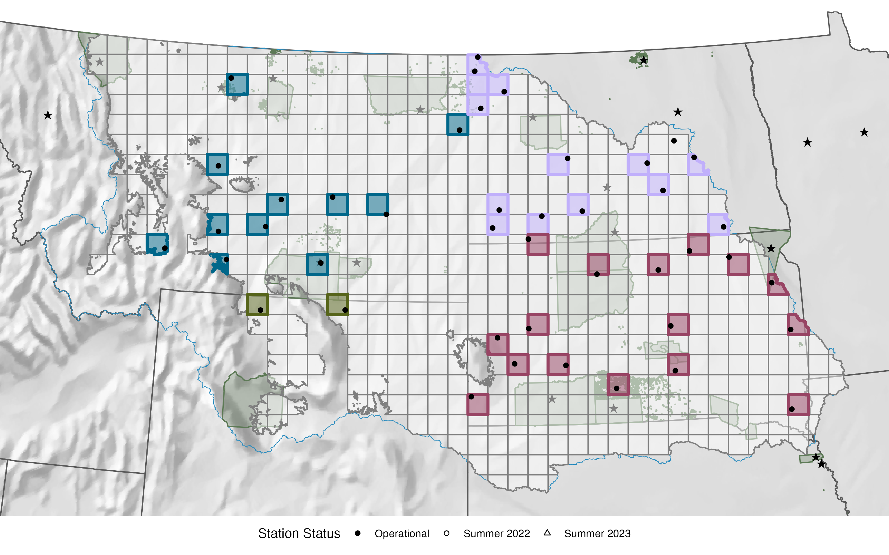
43 stations operational

Slide 11
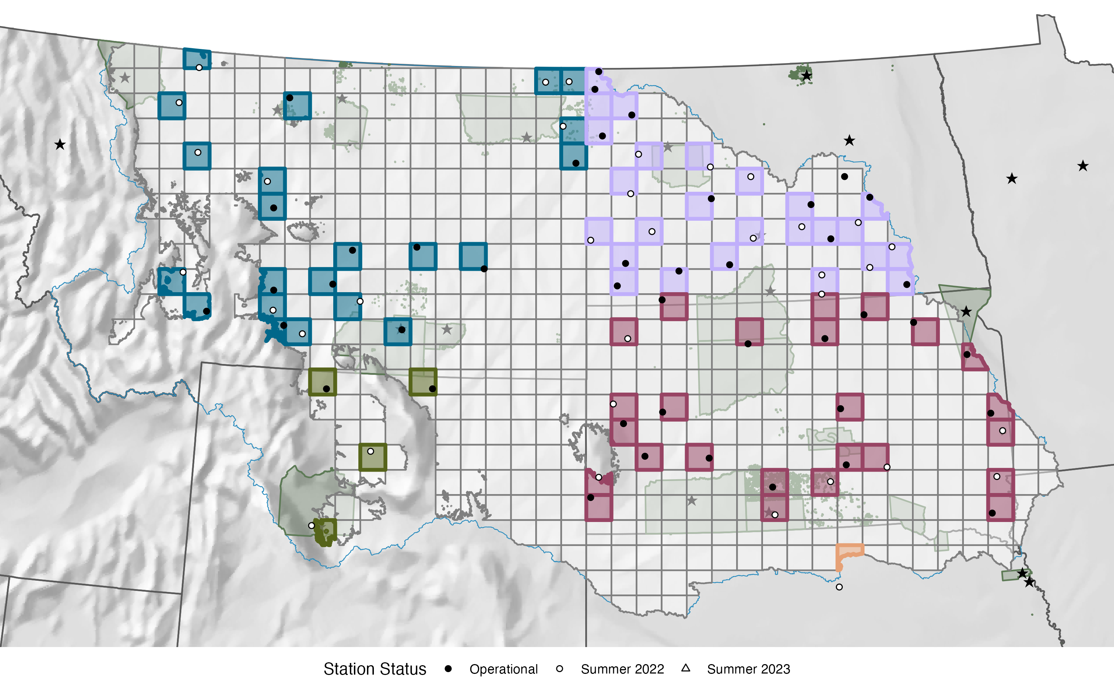
78 stations by winter 2022

Slide 12
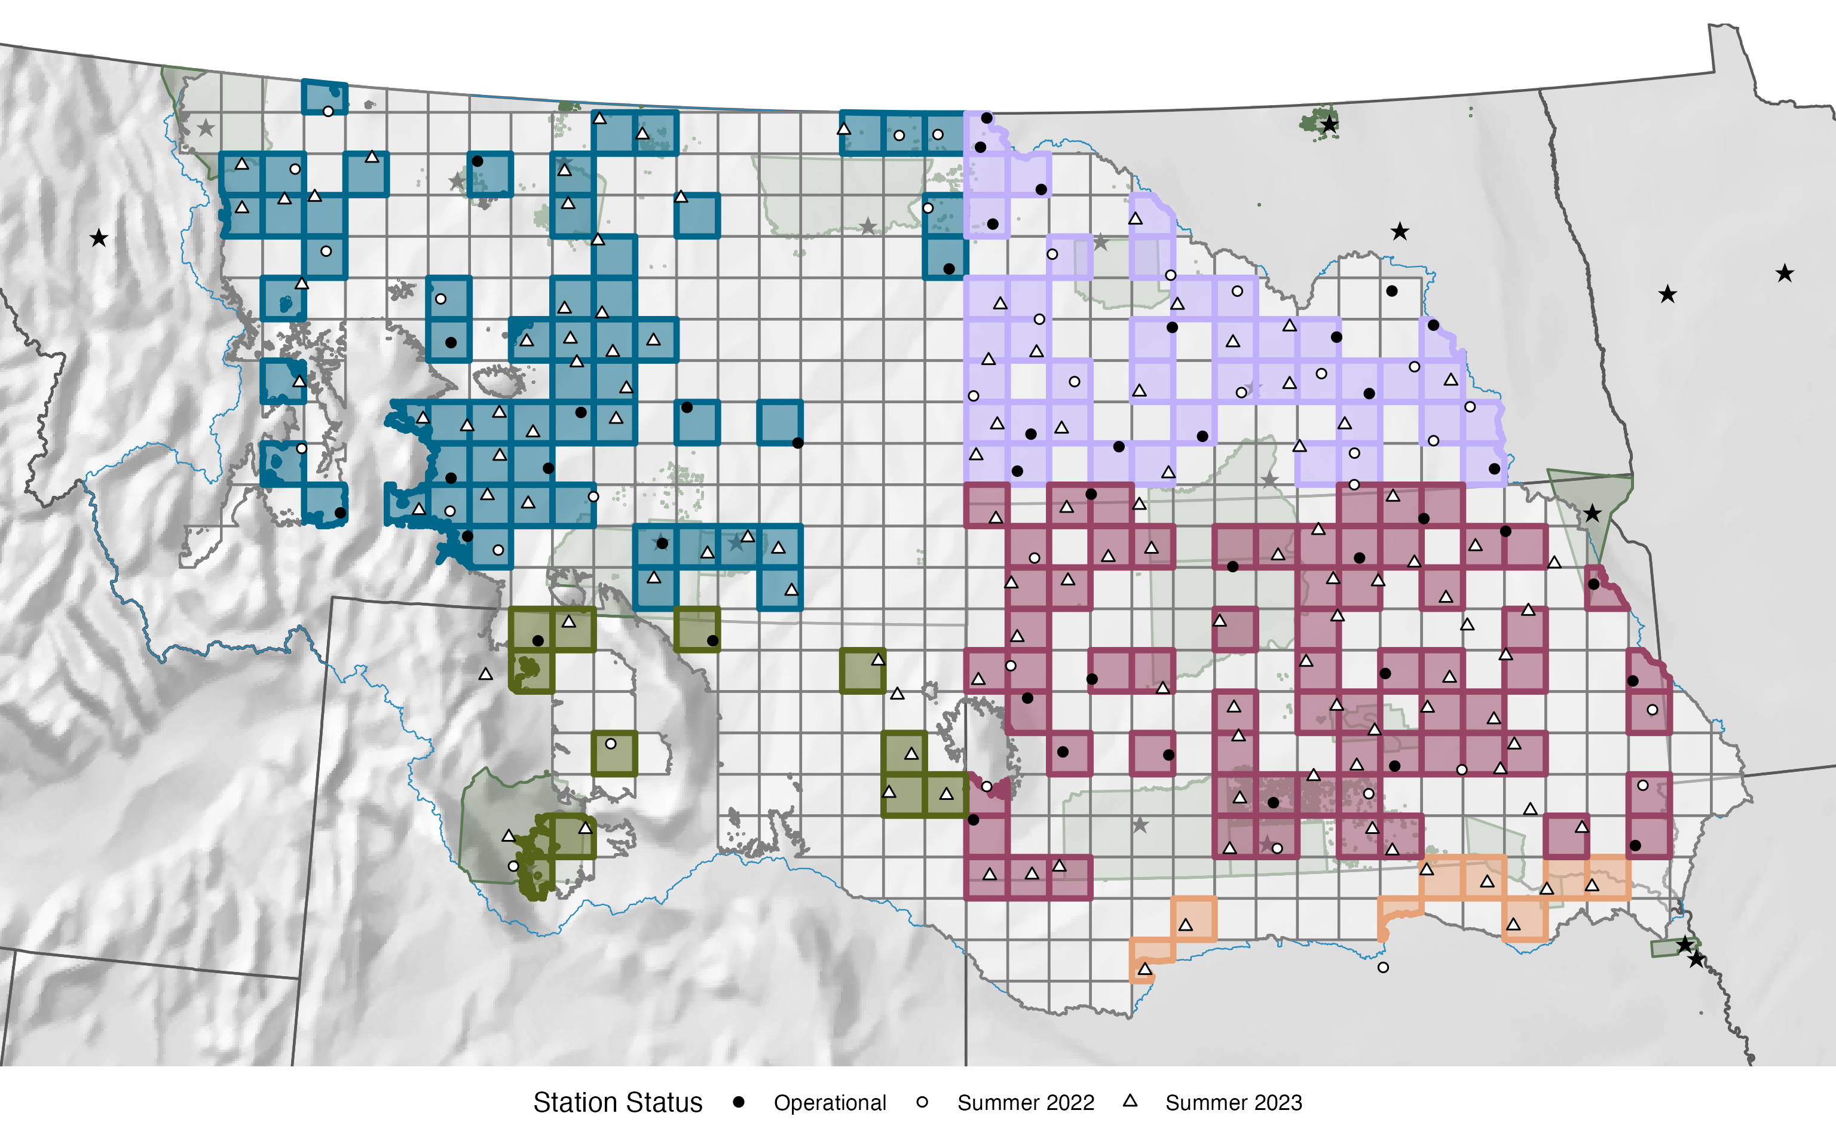
191 stations by winter 2023

Slide 13
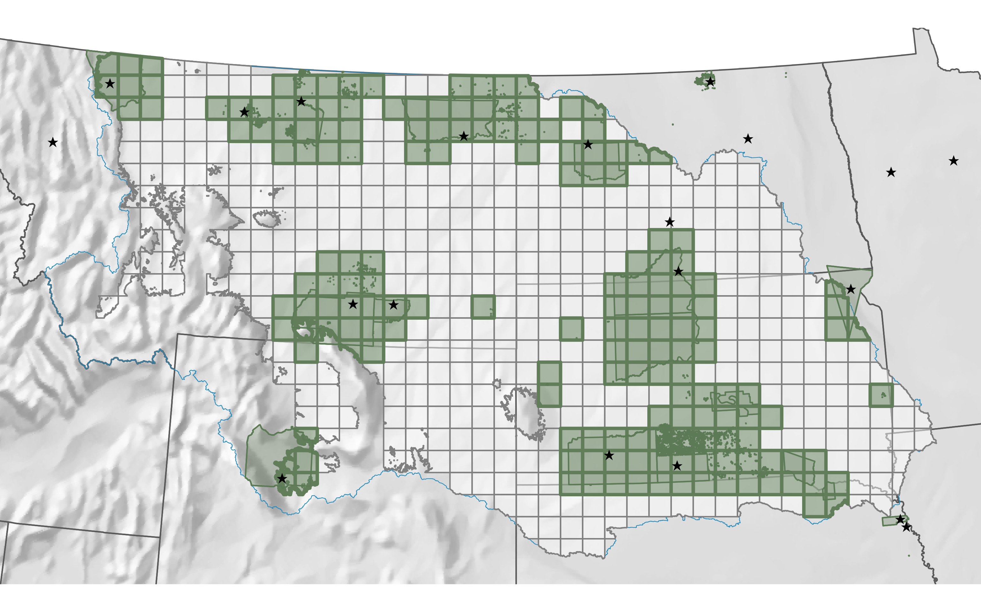
174 grid squares
include Tribal land

Slide 14
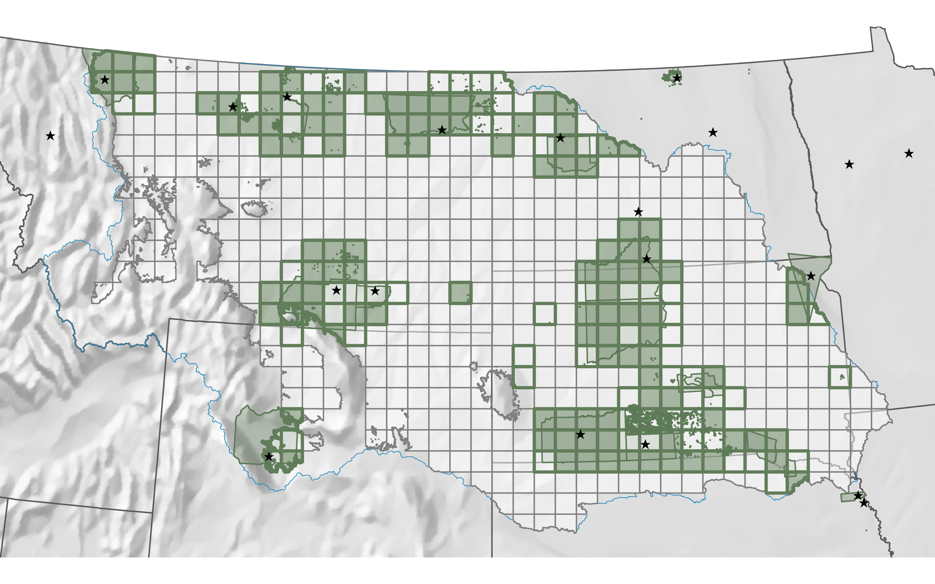
114 potential grid squares
to be filled on Tribal land

Slide 15
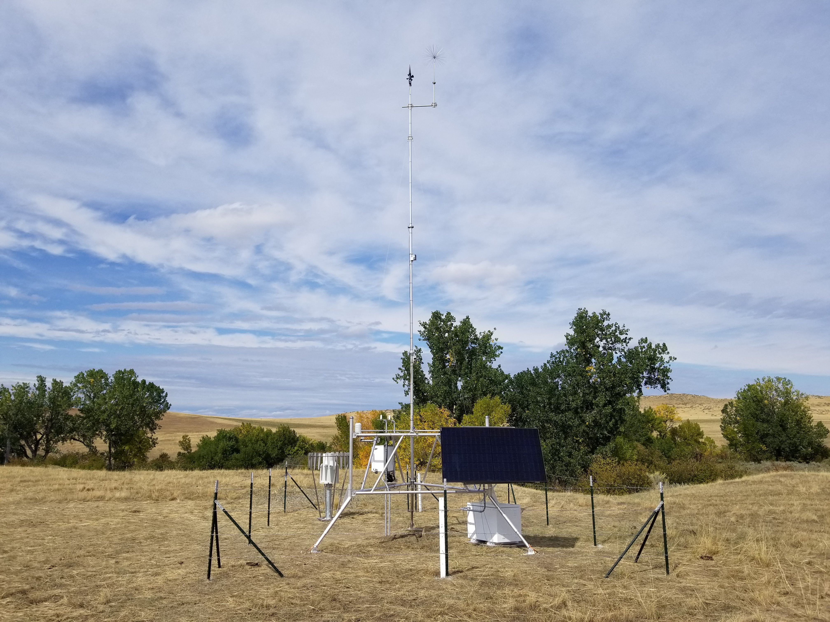
Montana Mesonet

Slide 16
Wind Speed &
Direction
Temperature &
Relative Humidity
Solar Radiation
Precipitation
Solar Powered
Soil Moisture/Temperature
@ 2”, 4”, 8”, 20”, 40”
Snow Depth/SWE
Montana Mesonet

Slide 17
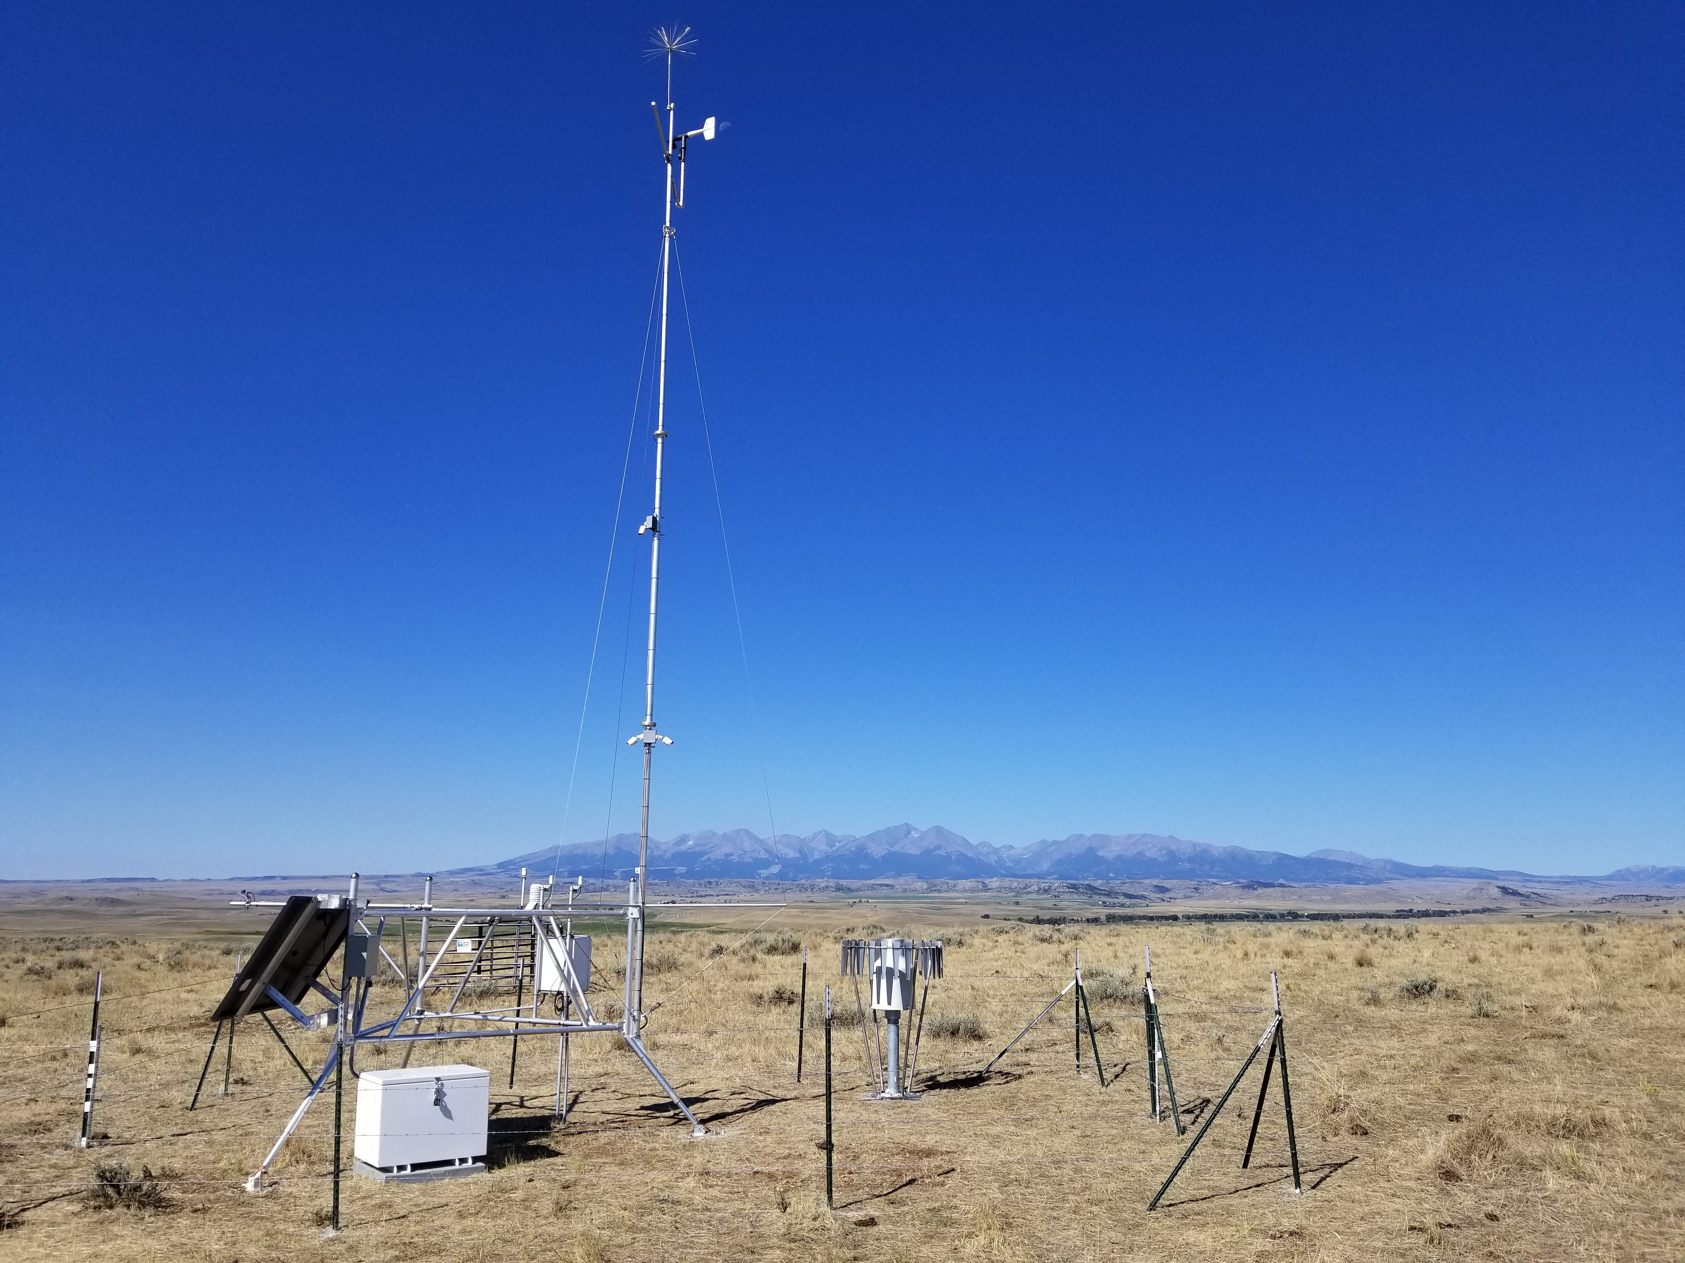
Seeking TCU Partnerships
Host a UMRB Soil Moisture station
Co-develop data displays for home communities
Mentorship and training for TCU students
Pathways towards co-management and restoration
Montana Mesonet

Slide 18
Thank You!
Questions?
kyle.bocinsky@umontana.edu
Montana Mesonet

